Slide 1
Three versions of Paradigm
12 July 2022
Presented by:
Matthew Bailes, Group CEO

Slide 2
WHERE ARE WE STARTING FROM?
LSVT – very first transfer over 30 years ago
Heartland one of the least deprived areas of the country; high market values
Now just over 16,000 homes
Largely vanilla business model – rent and shared ownership
Average SAP rating relatively good (73 v sector average c.68)
Strong margins – operating margin w/o sales c.40%
Only 4 blocks over 18m – none with cladding (now)
Stable treasury position (WACC = 3.7%), all drawn debt fixed, 49% gearing
G1 / V1; A+ (S&P)
Constraints: short-term – on-lending, impairment; long-term - gearing

Slide 3
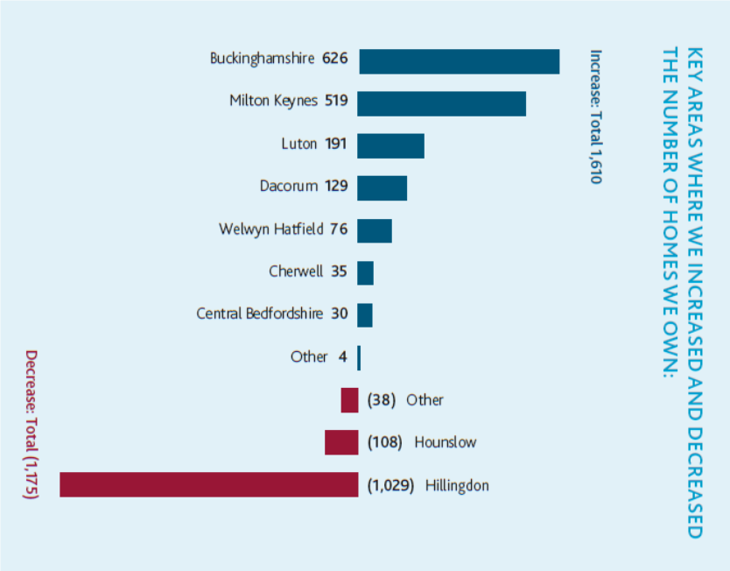
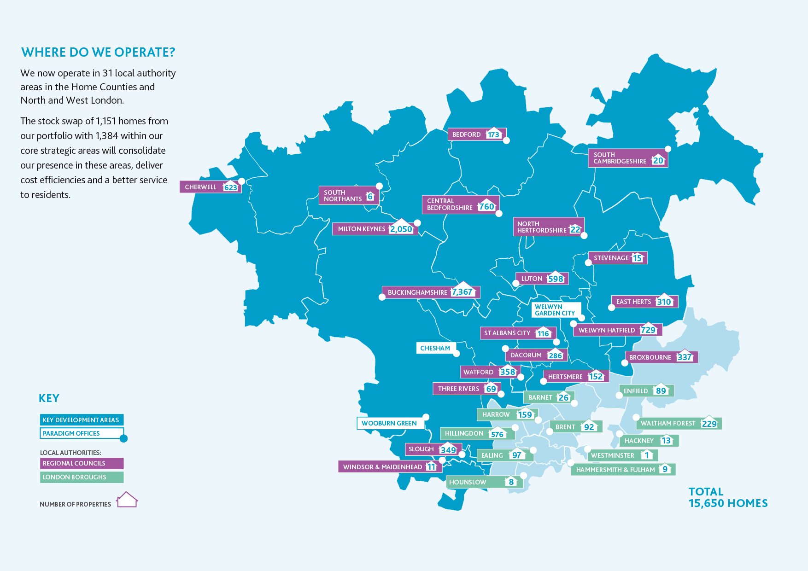
OPERATING AREA
Notes:
Larger and more local – move from London

Slide 4
MODELLING ASSUMPTIONS
Cautious on rents, interest rates, component life cycles, HPI etc.
EPC C by 2030; “net zero” by 2050
No assumed disposals
Covenant compliance maintained with gearing controlled within risk appetite
Variables: net costs zero carbon, rents v inflation next year
Development increased 50:50 tenure split up to “maximum” gearing level
Notes:
Highlight

Slide 5
THREE VERSIONS OF THE FUTURE
Paradigm A – net cost zero carbon = £0
Paradigm B – net cost zero carbon = £10k/unit
Paradigm C – rent freeze in 2023, net cost zero carbon = £22k/unit
Notes:
Highlight

Slide 6
RESULTS
 | Paradigm A | Paradigm B | Paradigm C
Maximum gearing | 64% (2051) | 64% (2051) | 64% (2051)
Minimum interest cover | 135% (2051) | 137% (2051) | 141% (2051)
Homes / annum | 600 | 520 | 300
Homes owned / managed 2051 | 34,000 | 31,500 | 26,000
Loss homes v Paradigm A | N/A | 2,500 | 8,000
Notes:
Highlight

Slide 7
OBSERVATIONS
Smooth spend profile of NZC important given annual interest cover tests…
…risk of collective optimism bias on the speed of progress given complexities?
New homes v Investment works = Apples v Pears
Role of disposals?
Lack confidence on grant funding affects development appetite now
Importance of future rent policy (!)
Very basic level question of who pays?
  Taxpayer through grant
  Residents / Taxpayer through rents
  People who would have got the homes we would have built with more funding
Notes:
Highlight

