Slide 1

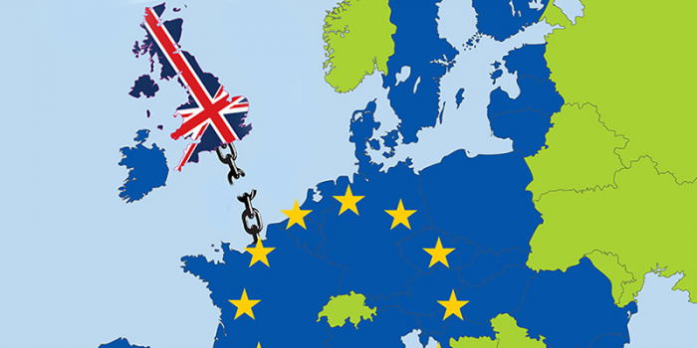
The Housing Finance Corporation:
Investor Update
May 2017

Slide 2
THFC
Legal Disclaimer
For the purposes of the following disclaimer, references to this presentation shall mean these presentation slides and shall be deemed to include references to any related speeches made by or to be made by the management of The Housing Finance Corporation Limited (THFC), any questions and answers in relation thereto and any other related verbal or written communications.
This presentation may only be communicated or caused to be communicated in the United Kingdom to persons who have professional experience in matters relating to investments falling within Article 19(5) of the Financial Services and Markets Act 2000 (Finance Promotion) Order 2005 (the “Order”) or high net worth entities who fall within Article 49(2) (a) to (d) of the Order (all such persons being referred to as “relevant persons”). Any investment or investment activity to which this presentation relates is available only to relevant persons and will be engaged only with relevant persons.
This presentation is being directed at you solely in your capacity as a relevant person (as defined above) for your information and may not be reproduced, redistributed or passed on to any other person or published, in whole or in part, for any purpose, without the prior written consent of THFC.
The information in this document is subject to change without notice, its accuracy is not guaranteed, and it may be incomplete and is condensed.
These presentation slides may contain certain statements, statistics and projections that are or may be forward-looking. The accuracy and completeness of all such statements, is not warranted or guaranteed. By their nature, forward-looking statements involve risk and uncertainty because they relate to events and depend on circumstances that may occur in the future. Although THFC believes that the expectations reflected in such statements are reasonable, no assurance can be given that such expectations will prove to be correct. There are a number of factors which could cause actual results and developments to differ materially from those expressed or implied by such forward-looking statements.

Slide 3
Five Year Financial Record
£000’s | 2013 | 2014 | 2015 | 2016 | 2017 (unaudited)
Total Revenues | 4,195 | 8,316 | 8,344 | 8,422 | 10,312
Total Costs | 2,341 | 3,662 | 3,201 | 4,301 | 4,176
Surplus after tax | 1,410 | 3,572 | 4,062 | 3,289 | 4,916
Group Accum. Reserves | 12,993 | 16,565 | 20,627 | 23,916 | 28,832
Group Loans Outstanding | 3,124m | 3,368m | 4,155m | 5,087m | 5,885m
THFC Limited Reserves | 8,861 | 12,248 | 14,238 | 14,986 | 17,666

Slide 4
Group 2017 results and 2018 budget
 | 2017 Actual (Unaudited) £000’s | 2018 Budget £000’s
Total Revenues | 10,312 | 9,043
Total Costs | (4,176) | (4,342)
Surplus after tax | 4,916 | 3,760
Accum. Reserves | 28,832 | 32,592
Loans Outstanding | 5,885m | 6,645m
Budgeted 2018 revenues once again driven by remaining AHF bond/EIB arrangement fees, associated growth in annual fees and some incremental THFC lending.
Budgeted 2018 costs in line with 2017 but may be subject to further pension provision

Slide 5

THFC: Standard & Poor’s Rating
Major Rating Factors
Strengths | Relatively strong franchise value Strong support from the UK Government, which underpins borrower creditworthiness Robust collateralisation of loan book Match-funded approach minimizes asset-liability risk
Weaknesses | Modest liquid financial resources and low capital levels Exposure to single sector, with borrower-concentration risk Potential for conflicts of interest could arise from board composition and responsibilities Vulnerable to operational risk stemming from small staff numbers and key personnel risk
THFC’s S&P Rating was lowered one ‘notch’ to A Stable following the UK Sovereign downgrade in July 2016.
Prior to this, THFC’s rating had remained unchanged at A+/Stable/A-1 since first obtained in 2004
Now classified as a Finance Company along with other companies whose primary focus is lending to the public sector or lending to government-supported borrowers
Rating potentially includes one notch ‘Government Related Entity’ uplift from SACP

Slide 6
THFC Limited – portfolio data

Slide 7
THFC Ltd Rated Issuance
Bond | Rating (S&P) | Outstanding £k | Index Constituent
Funding No.1 | A | 235,205 | iBoxx
Funding No.2 | A | 370,850 | iBoxx
Funding No.3 | A | 625,300 | iBoxx
THFC Ltd Loan Portfolio as at 31 Mar 17

Slide 8
Exposure balances by HA Group
31 Mar 17
THFC — Top 10 exposures
 | Borrower (Group) |  | Rating | Current Balance
1 | Southern | G15 | A1 | 144,163
2 | A2Dominion | G15 | A+ | 132,477
3 | Network | G15 | - | 130,940
4 | Family Mosaic | G15 | A1 | 82,698
5 | Home |  | A | 65,356
6 | Paradigm |  |  | 65,000
7 | Hyde | G15 | A+ | 62,622
8 | Thames Valley |  |  | 53,936
9 | Genesis | G15 | Baa1 | 50,500
10 | Westcountry |  |  | 47,000

Slide 11
Asset Cover History
Quarter End | THFC Group | THFC Only
 | % | %
31/03/2017 | 240 | 221
31/03/2016 | 233 | 216
31/03/2015 | 226 | 209
31/03/2014 | 228 | 211
31/03/2013 | 233 | 215
31/03/2012 | 244 | 221
31/03/2011 | 254 | 237
31/03/2010 | 296 | 275
31/03/2009 | 318 | 306
31/03/2008 | 294 | 293
Significant new business written between 2009 and 2013 with asset cover between 150% and 200%
Withdrawal threshold at 200% delivers improved over-collateralisation over the long term
Significantly more conservative compared to own-name bond issues where 115% MVT cover is the norm

Slide 12
Liquidity Resources in Stress Scenario
(underlying borrower default)
Loans funded by bonds issued by THFC (Funding No 1) plc, THFC (Funding No 2) plc and THFC (Funding No 3) plc have bespoke liquidity resources and a two year grace period between legal final and expected final maturity dates.
THFC (Funding No 1) plc (the Issuer) has the benefit of access to a liquidity facility provided by RBS
  Sized at 2 years’ of interest (£24.1million supporting £235.2million of debt)
  Following downgrade of RBS (short term rating) the facility has been drawn in full and held in cash
  Can be utilised to cover any cash flow shortfall at the Issuer level (i.e. not just in the event of non-payment by an underlying borrower)
THFC (Funding No 2) plc and THFC (Funding No 3) plc
  Underlying loans to individual borrowers have a requirement for an interest service reserve equal to one year of interest
  Can be used by THFC to service its loan to Funding No 2 or Funding No 3 in the event of non-payment of interest by an underlying borrower under the terms of specific loan agreement
  Total interest service reserves of £56million supporting £996.15million of debt
12

Slide 13
Liquidity Resources in Stress Scenario
(underlying borrower default)
Loans funded by Debenture Stocks and bank loans have no bespoke liquidity resources. Liquidity to cover cash-flow shortfalls in relation to any defaulted loan would be limited to THFC’s cash reserves and any bespoke facilities negotiated.
Key metric for each borrower - annual cashflow with no liquidity risk mitigation
Top 20 as at 31 March 2017 below – includes capital repayments for amortising loans but bullet maturities monitored separately
THFC reserves £17.66million

Slide 14
11.5% Debenture Stock maturity 2016
Key maturity in October/November 2016 when £156.5m of loans and debenture stock matured
Spread across 38 borrower groups
Largest single amount due – P&I £20.6million
....... BUT we had a plan – outlined last year
All borrowers repaid on the day – payments collected, in most cases, by direct debit.
Funds invested for 1 month in T-bills
Stockholders repaid on the maturity date in accordance with the provisions of the Trust Deed

Slide 15
Bullet repayment debt maturity profile – debenture stocks
2016 Debenture stocks fully repaid

Slide 16
Debenture Stock maturity 2023
After 2016 the next key maturity is October/November 2023 when £189m of debenture stock matures
Spread across 46 borrower groups
THFC reserves as at 31 March - £17.66million
Forecast reserves 2023 - £26million

Slide 17
AHF summary

Slide 18
THFC/AHF Business Volumes (including remaining AHF pipeline)

Slide 19
AHF – the most successful
Government Guarantee programme
Loans signed and drawn £2.435billion
Loans signed but undrawn £0.551billion
64 Borrower Groups to date (average loan size larger than THFC)
Progressing through credit and/or documentation £0.246billion
Estimated Portfolio Total £3.232billion - funded by EIB facilities and long term bond issues

Slide 20
THFC – the next steps

Slide 21
Incremental new lending
  Demand building up for both incremental long term funding and refinancing presents opportunities for selective new lending
  HAs are forecast to repay at least £2bn of debt per year for the next 10 years. The annual repayment in the early years has increased as banks have shortened their maturities.
  HA debt raising is expected to be at least £3bn per year
  Bank lending accounted for 60% of the new funding in Q3 of 16/17 (the latest data available); capital markets, including private placements and aggregated bond finance, contributed the remaining 40%
  Funding via THFC (Funding No 3) and THFC Limited provides quick route to market
  Investor familiarity with THFC and what differentiates investing in THFC versus a portfolio of own name bonds and private placements delivers competitive pricing

Slide 22
What differentiates THFC
  Uniquely placed to assess HA credit in depth across the sector in all parts of the UK
  Highly skilled and experienced teams in relationship management and credit and risk function – focussing solely on the HA sector
  Access to data and to management teams and boards of HAs allows much more in depth analysis than bondholders are able to perform and the latter enables THFC to make informed judgements about governance and culture

Slide 23
Credit Review
Non-financial review | Financial Review
Stock condition and associated asset management programme/ investments needs | Last 3 years historical accounts on initial review (management accounts and statutory accounts reviewed on an ongoing basis)
Development programme, track record and capability | Financial plan and 30 year forecasts (reviewed annually)
Strength and composition of senior management team | Financial plan stress testing (reviewed annually)
Strength and composition of Board and governance structure | Treasury policy and liquidity
Potential exposure to “Welfare Reform”. | Financial Covenants.
 | Hedging policy and exposure to interest rate volatility
 | Key financial metrics (reviewed annually)

Slide 24
Key Financial Metrics
These include;
  a) Operating margins.
  b) Leverage (multiples of debt/turnover and debt/EBITDA)
  c) Interest coverage on EBITDA MRI basis i.e. after deducting
  any capitalised spend on major repairs
Why use EBITDA MRI debt service coverage as key measure?
Operating cash-flow (for which we use EBITDA as proxy) ought to be sufficient to cover:
  The ongoing investment needs of the stock to maintain it in good condition.
  Cash interest costs as they fall due, and leave something over to pay-down debt over time.

Slide 25
Financial Plan Stress Testing
Part of financial assessment – will require sight of Board supported multi-variate stress testing scenarios.
Expect scenarios to include:
Rent variants outside of the current formula.
High inflation / high interest rate situations.
Hair cuts and delays to sales proceeds where an association has shared ownership or outright sales schemes planned.
Adverse Welfare Reform impacts.
THFC reviews impact of stress scenarios on covenants and level of debt required vs. available liquidity.

Slide 26
Sector Outlook

Slide 27

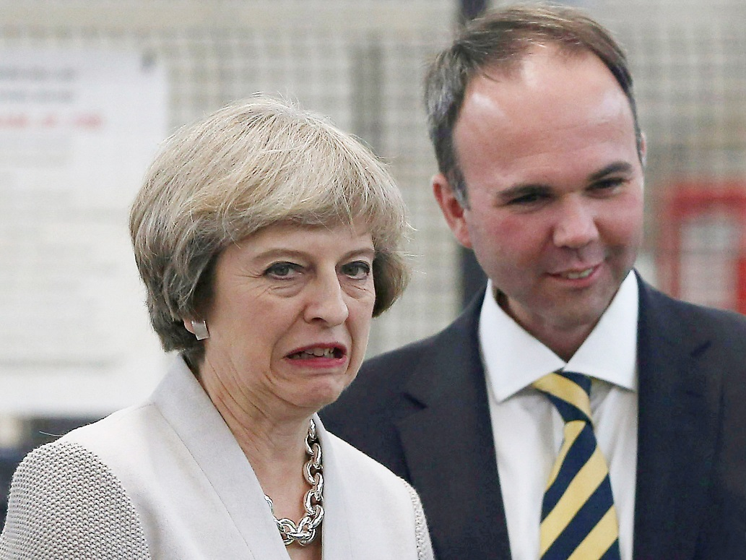

The policy pendulum swings from:
home-ownership to address all tenures
1.5 Million Homes by
2022
1 Million Homes by
2020

Slide 28
The policy pendulum swings from:
home-ownership to address all tenures
2015 Policy | 2017 Policy
Home ownership for everyone | Wider choices of tenure reflecting affordability
£4.7Bn grant primarily for home-ownership (back-loaded) | £4.7Bn +£1.4Bn grant for broader mix of tenures (pulled forward in AFS)
Voluntary RTB for HAs | Pilots…but unaffordable?
4 * 1% Rent Cuts to 2019 | Post 2020?
Re-classification | De-classification
Welfare expenditure control | Welfare expenditure control?

Slide 29


HA Rent Post 2020
Business plans typically assume CPI flat or CPI + 1% post 2020
Stress tests for developing HAs go further but high correlation between strong operating margins and ability to survive heavy stress assumptions!
Wide spectrum of approaches to cost savings
Most HAs forecast lower operating margins by 2020
LHA indexing freeze and potential capping from 2019 could have a material impact: particularly in areas of limited demand and for supported housing
To date DWP holding firm on Welfare cuts
Significant uncertainty until Green Paper publication, post Gen. Elcn’.

Slide 30
English Housing Starts
HA starts don’t
Reflect all S106
“On the subject of housing, the British are experts. Most people either own one or want to. And demand usually grows by 200,000 units per year; each year only about 150,000 are built. Steadily rising house prices are the result of this mismatch”. FT Lex 23 August 2016

Slide 31
Volume builder fact file
Top eight volume housebuilders delivered at least 54% (circa 65,000) all housing completions in 2015
Operating margin of top builders at 17.6% is nearly at cross cycle peak (17.8%)
Post tax RoE at 19.5% is close to 21.6% peak
69% of smaller housebuilders currently quote access to land as their biggest barrier to growth
NPPF is working (permissions at 275k in 2016 have more than doubled in 4 years)
Farmer review on skills shortages in the next 5 years quotes 700,000 retiring skilled building trades, and 25,000 apprentices
JLL housing Start data
 |  |  |  |  | Forecast
000s | 2007 | 2012 | 2014 | 2015 | 2016 | 2017 | 2018 | 2019 | 2020 | 2021
English housing starts | 184 | 101 | 141 | 146 | 140 | 134 | 134 | 136 | 140 | 146
London Housing Starts | 21.5 | 16.5 | 18.1 | 23.7 | 18 | 16 | 16 | 18 | 21 | 23

Slide 32


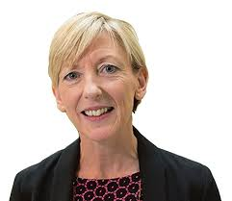
Does de-regulation impact capacity?
Core regulation tools remain:
    Setting standards
    Enforcement toolset for non-compliance
Features of Deregulation:
    Removal of consents for constitutional change
    Removal of consents for disposals
    Introduction of regulator notification of constitutional changes, restructures and disposals
    Removal of disposals proceeds fund
Efficiency: Social Housing Cost per Unit
Housing Administration

Slide 33
Sales Exposure
Outright sales, First tranche sales, fixed asset sales
Historic accounts focus on London-centric sales
Forward looking sales show a more national picture and rapid growth of individual programmes
More nuanced analysis would look at timing, clustering, expertise as well as liquidity

Slide 34

Mergers: the big fish eat the small fish?
Ozmo: Big Fish Eat Small Fish. Cargo, Shoreditch (After Bruegel the Elder and Ingris)

Slide 35

What does BREXIT mean for HAs?
Domestically focussed industry
Demand/housing need remains high
Skills: the Farmer Review: exposed to differential inflation
Uncertain investment environment
Progressively more freedoms from Government?

Slide 36


Geo-Political Risk

Slide 37


Constraints in an uncertain world
The uncertainty!
Potential for the super-prime London correction to filter down
Free cash-flow (or lack of it)
Lender covenants
Drive for efficiency
Differential inflation
Skills shortages
Lack of consistent policy
Lack of development sites
If HAs don’t use development capacity……..!
BUT
BREXIT could drive domestic investment
Relaxation of elimination of structural deficit
Lowest long term interest rates….ever!
Chronic shortage of affordable housing

Slide 38
Conclusion
The first half of 2017/18 is a transition period
  Completion of the AHF underwriting with a portfolio of over £3billion with c.65 borrowers
  Review of new lending opportunities
Our underwriting and portfolio management expertise gives us a detailed knowledge of how HAs are responding to a variety of market challenges
We will use this knowledge to underwrite selective incremental credit – first in THFC Limited
We will assess the business case for a new funding vehicle later in 2017/18

Slide 39
Questions

Slide 40
Appendix

Slide 41
The Housing Finance Corporation
Limited — Structure Overview
Issued Bonds
Issued Bonds
Issued Bonds
Issued Bonds
Loans
Public stocks
11.50% stock due 2016
8.625% stock due 2023
9.625% stock due 2027
Plus PPs
£67.6m AA- (issued Dec 2004)
£32m AA- (tap Dec 2006)
£37m AA- (tap March 2007)
£33m AA- (tap Dec 2007)
£80m AA- (tap Aug 2008)
£191m A+ (issued July 2009)
£72.25m A+ (tap March 2010)
£76.6m A+ (tap Jan 2011)
£31m A+ (tap March 2011)
£100m A+ (issued Oct 2011)
£131m A+ (issued Jan 2012)
£130.5m A+ (issued Apr 2012)
Trustee/s in relation to
THFC
Debentures and Private Placements
THFC Funding No.1 PLC (“THFC 1”)
(Issuer Rating AA-)
THFC Funding No.2 PLC (“THFC2”)
(Issuer Rating A+)
THFC Funding No.3 PLC (“THFC 3”)
(Issuer Rating A+)
EIB and
other Banks
Security — floating charge over THFC’s assets (secured loans)
All secured creditors are pari passu
Relationship between secured creditors regulated by Deed of Priority
The Housing Finance Corporation Limited (“THFC”)
Security – first fixed charges over specific residential properties
(or, initially, over cash)
Housing Association
Housing Association
Housing Association
Housing Association
Housing Association
Housing Association
Housing Association
Housing Association
Housing Association
Housing Association
Housing Association
Housing Association

Slide 42
THFC Group Structure
The Housing Finance Corporation Limited
T.H.F.C. (Indexed) Limited
T.H.F.C. (Indexed 2) Limited
T.H.F.C. (First Variable) Limited
T.H.F.C. (Social Housing Finance) Limited
Principal debt issuing entities
T.H.F.C. (Services) Limited
UK Rents (Holdings) Limited
T.H.F.C. (Capital) Plc
Affordable Housing Finance PLC
UK Rents Trustee Limited
UK Rents (No.1) Plc

Slide 43
THFC Management
Chief Executive
Piers Williamson
Executive Assistant
Group Treasurer
Fenella Edge
Finance Director and Company Secretary
Colin Burke
Credit and Risk Director
David Stokes
Relationship Management
Security Portfolio
Management
Treasury and Portfolio
Management
Accounting and Finance
Managed Companies –
Monitoring and Reporting
Company Secretarial
Borrower risk assessment
Risk appetite
Risk framework
Credit grading models

Slide 44
THFC Non Executive Board Members
Ian Peacock * | Non Executive Chairman Investment and merchant banker. Retiring Chair of Family Mosaic Housing Group | Appointed 2013
Will Perry | Assistant Director of Regulatory Strategy & Performance HCA | Appointed 2014
Gill Payne * | Director of Policy and External Affairs National Housing Federation | Appointed 2014
Keith Exford CBE | Group Chief Executive Clarion Housing Group | Appointed 2011
John Parker * | Chartered Accountant, Vice Chairman Newbury Building Society, former building society Chief Executive and Chairman Building Societies Association | Appointed 2010
Deborah Shackleton CBE * | Former Chief Executive Riverside Housing Group, Governor Liverpool John Moores University, Board Member NHS Sefton | Appointed 2011
Charlie Arbuthnot ** | Ex-investment banker: Warburgs, Hambros & RBC Capital Markets. Now housing consultant | Appointed 2008
* Member of THFC Credit Committee ** Chair of THFC Credit Committee

